Slide 1
Introduction to Computer Networks

Slide 2
Acknowledgement
These slides are taken (as it is or with some modifications) from various resources including -
Comuter Networking: A top-down approach (Book and Slides) by Jim Kurose and Keith Ross
Data Communication and Networking with TCP/IP Protocol Suite (Book and Slides) by Behrouz A. Forouzan

Slide 3
Motivation
When someone talks about computer networks, the first things that comes to our mind is the internet.
But what internet actually is? and how it works?
The actual definition of the internet can vary depending upon whom you are asking.
In this course, we will talk about the internal workings of internet.
https://www.youtube.com/watch?v=Dxcc6ycZ73M&ab_channel=Code.org

Slide 4
















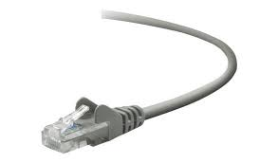
The Internet: a “nuts and bolts” view
Billions of connected computing devices:
hosts = end systems
running network apps at Internet’s “edge”
mobile network
national or global ISP
Packet switches: forward packets (chunks of data)
routers, switches
local or regional ISP
Internet
Communication links
fiber, copper, radio, satellite
transmission rate: bandwidth
home network
content
provider
network
datacenter
network
Networks
collection of devices, routers, links: managed by an organization
enterprise
network

Slide 5
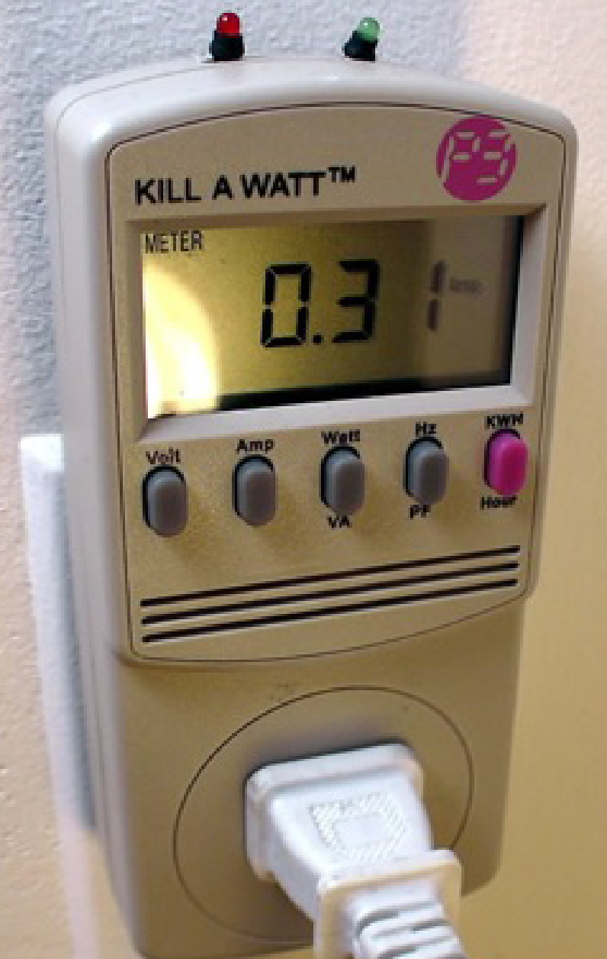






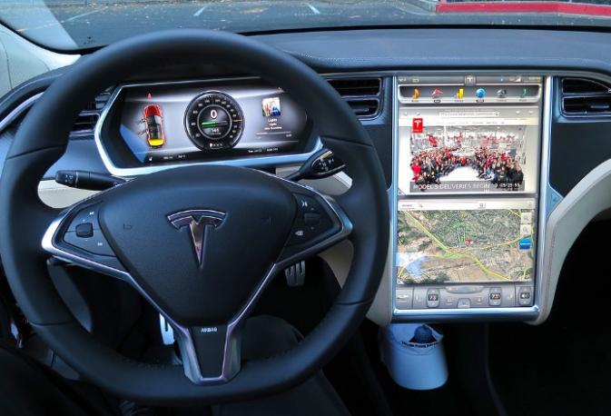






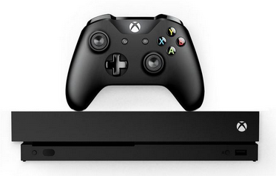



“Fun” Internet-connected devices
Tweet-a-watt:
monitor energy use
bikes
Pacemaker & Monitor
Amazon Echo
Web-enabled toaster +
weather forecaster
IP picture frame
Internet
refrigerator
Slingbox: remote
control cable TV
cars
Security Camera
AR devices
sensorized,
bed
mattress
scooters
Fitbit
Others?
Gaming devices
Internet phones
diapers

Slide 6
The Internet: a “nuts and bolts” view
mobile network
4G
Internet: “network of networks”
Interconnected ISPs
national or global ISP
protocols are everywhere
control sending, receiving of messages
e.g., HTTP (Web), streaming video, Skype, TCP, IP, WiFi, 4/5G, Ethernet
IP
Streaming
video
Skype
local or regional ISP
home network
content
provider
network
HTTP
datacenter
network
Ethernet
TCP
enterprise
network
WiFi

Slide 7
The Internet: a “services” view
Infrastructure that provides services to applications:
Web, streaming video, multimedia teleconferencing, email, games, e-commerce, social media, inter-connected appliances, …
mobile network
national or global ISP
Streaming
video
Skype
local or regional ISP
home network
content
provider
network
HTTP
datacenter
network
enterprise
network

Slide 8
What is a Computer Network?
A computer network is the interconnection of a set of devices capable of communication.
These devices can be either a host (also called end system sometimes) such as a large computer, desktop, laptop, workstation, cellular phone, TV, etc. Or a connecting device such as a router which connects the network to other network, a switch which connects devices together, a modem (modulator-demodulator) that changes the form of data, and so on.
These devices in a network are connected using wired or wireless transmission media such as ethernet, WiFi, etc.

Slide 9
Connected computing devices:
hosts = end systems
running networking apps at the “edge” of the network
mobile network
national or global ISP
Packet switches: forward packets (chunks of data)
routers, switches
local or regional ISP
Internet
Communication links
fiber, copper, radio, satellite
transmission rate: bandwidth
home network
content
provider
network
datacenter
network
Networks
collection of devices, routers, links: managed by an organization
enterprise
network

Slide 10
Network Criteria
A network must be able to meet a certain number of criteria. Some of which are -
Performance - A network should provide efficient communication. Performance of a network is measured using two things -
Transit time - Time spend by a message in the network before reaching to the destination.
Response time - After receiving a query, time taken by a computer to generate the response.
Reliability - The Reliability of a network is measured by the frequency of failures it is undergoing and the time it takes to recover from the failures. Overall, the Robustness of the Network at times of catastrophic events is measured to check how reliable the Network is.
Security - Network security issues include protecting data from unauthorized access, protecting data from damage and development, and implementing policies and procedures for recovery from breaches and data losses.

Slide 11
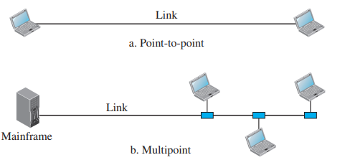
Physical Structures of Networks
A network is two or more devices connected through links. A link is a communications pathway that transfers data from one device to another.
For communication to occur, two devices must be connected in some way to the same link at the same time.

Slide 12
Network Topologies
Network topology refers to the arrangement of different elements like nodes, links, and devices in a computer network.
It defines how these components are connected and interact with each other.
Understanding various types of network topologies helps in designing efficient and robust networks.
Common types include bus, star, ring, mesh, and tree topologies, each with its own advantages and disadvantages.
Notes:
- Ask students to connect five devices with other in any manner they see fit.

Slide 13
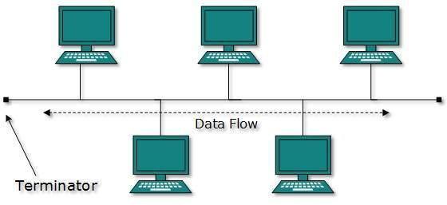
Types of Network Topology
Bus Topology
In case of Bus topology, all devices share single communication line or cable.
It is one of the simple forms of networking where a failure of a device does not affect the other devices. But failure of the shared communication line can make all other devices stop functioning.
Both ends of the shared channel have line terminator. The data is sent in both directions and as soon as it reaches the extreme ends, the terminator removes the data from the line.

Slide 14
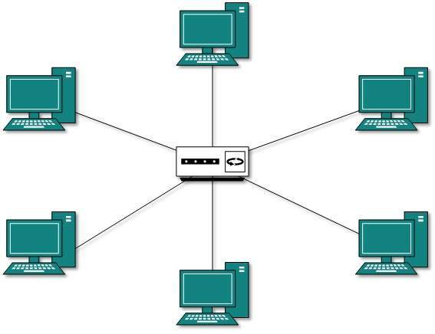
Types of Network Topology
Star Topology -
In Star Topology, all the devices are connected to a single hub through a cable.
This hub is the central node and all other nodes are connected to the central node.
If hub fails, connectivity of all hosts to all other hosts fails. Every communication between hosts, takes place through only the hub.
Star topology is not expensive as to connect one more host, only one cable is required and configuration is simple.

Slide 15
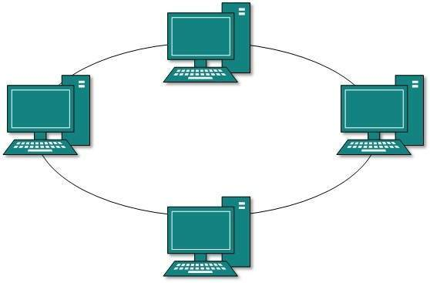
Types of Network Topology
Ring Topology -
In ring topology, each host machine connects to exactly two other machines, creating a circular network structure.
When one host tries to communicate or send message to a host which is not adjacent to it, the data travels through all intermediate hosts.
To connect one more host in the existing structure, the administrator may need only one more extra cable.
Failure of any host results in failure of the whole ring as the data travels in only one direction in ring network structure. Thus, every connection in the ring is a point of failure.

Slide 16
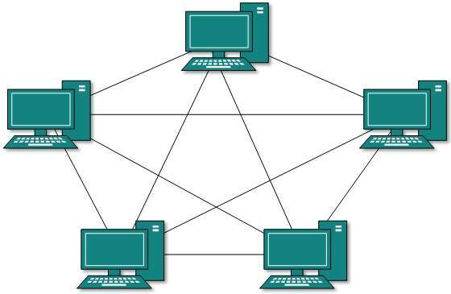
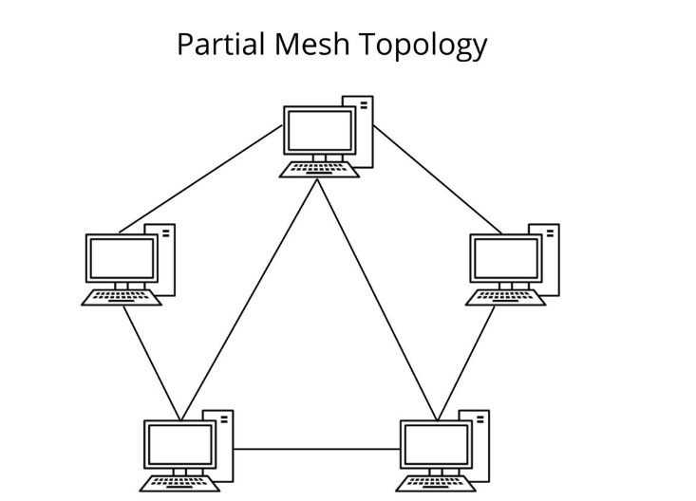
Types of Network Topology
Mesh Topology -
In this type of topology, a host is connected to one or multiple hosts.
Hosts in Mesh topology also work as relay for other hosts which do not have direct point-to-point links.
Full Mesh - All hosts have a point-to-point connection to every other host in the network. It provides the most reliable network structure among all network topologies.
Partially Mesh - Not all hosts have point-to-point connection to every other host. Hosts connect to each other in some arbitrarily fashion. This topology exists where we need to provide reliability to some hosts out of all.

Slide 17
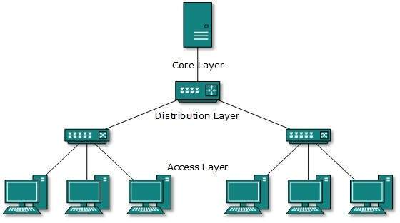
Types of Network Topology
Tree Topology or Hierarchical Topology
This topology divides the network in to multiple levels/layers of network.
The lowermost is access-layer where computers are attached.
The middle layer is known as distribution layer, which works as mediator between upper layer and lower layer.
The highest layer is known as core layer, and is central point of the network, i.e. root of the tree from which all nodes fork.
Similar to the Bus topology, if the root goes down, then the entire network suffers even though it is not the single point of failure.
Every connection serves as point of failure, failing of which divides the network into unreachable segment.

Slide 18
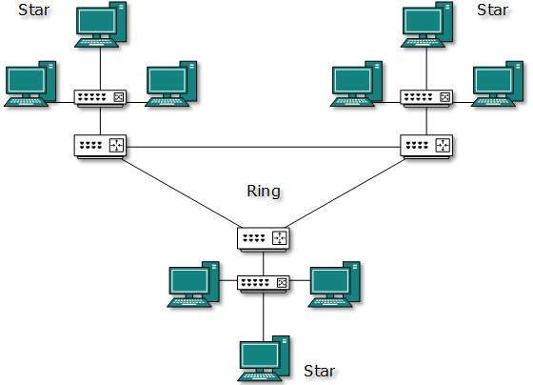
Types of Network Topology
Hybrid Topology
A network structure whose design contains more than one topology is said to be hybrid topology. Hybrid topology inherits merits and demerits of all the incorporating topologies.
Internet is the best example of largest Hybrid topology.

Slide 19
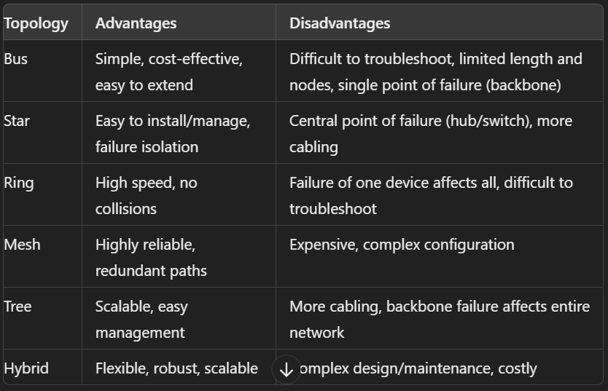
Comparison of Network Topologies

Slide 20
Types of Computer Networks
Depending upon size and connection range, networks can be divided into several categories -
Personal Area Network (PAN)
Local Area Network (LAN)
Campus Area Network (CAN)
Metropolitan Area Network (MAN)
Wide Area Network (WAN)
Point-to-Point WAN
Switched WAN

Slide 21
Types of Computer Networks
Personal Area Network (PAN)
A PAN is the smallest type of network, covering a very limited area, typically within the range of an individual person.
Range - Up to a few meters
Local Area Network (LAN)
A LAN covers a small geographic area such as a single building, office, or home. It is used to connect computers and devices within close proximity.
Range - Up to a few kilometers.

Slide 22
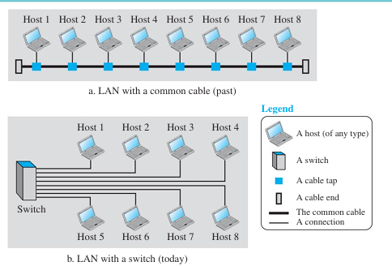

Slide 23
Types of Computer Networks
Metropolitan Area Network (MAN)
A MAN covers a large geographic area than a LAN, typically spanning a city or a large campus. It connects multiple LANs within a specific region.
Range - Up to 50 kilometers.
Wide Area Network (WAN)
A WAN covers a broad area, often a country or continent. It connects multiple LANs and MANs.
Range - Thousands of kilometers.

Slide 24

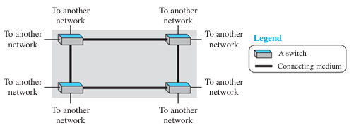
Wide Area Network
Point-to-Point WAN:
Switched WAN:

Slide 25
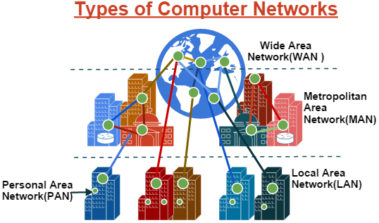

Slide 26
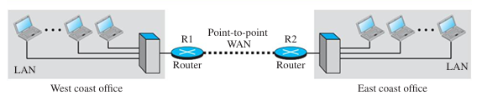
Inter-Network
Today, it is very rare to see a LAN or a WAN in isolation; they are connected to one another. When two or more networks are connected, they make an internetwork, or an internet.
As an example, assume that an organization has two offices, one on the east coast and the other on the west coast. Each office has a LAN that allows all employees in the office to communicate with each other. To make the communication between employees at different offices possible, the management leases a point-to-point dedicated WAN from a service provider, such as a telephone company, and connects the two LANs. Now the company has an internetwork, or a private internet (with lowercase i).

Slide 27
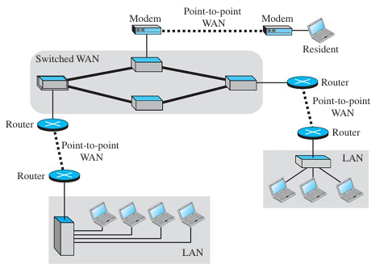
Inter-Network

Slide 28
The Internet: a “nuts and bolts” view
Billions of connected computing devices:
hosts = end systems
running network apps at Internet’s “edge”
mobile network
national or global ISP
Packet switches: forward packets (chunks of data)
routers, switches
local or regional ISP
Internet
Communication links
fiber, copper, radio, satellite
transmission rate: bandwidth
home network
content
provider
network
datacenter
network
Networks
collection of devices, routers, links: managed by an organization
enterprise
network

Slide 29
Internet structure: a “network of networks”
hosts connect to Internet via access Internet Service Providers (ISPs)
access ISPs in turn must be interconnected
so that any two hosts (anywhere!) can send packets to each other
resulting network of networks is very complex
evolution driven by economics, national policies
mobile network
national or global ISP
local or regional ISP
home network
content
provider
network
datacenter
network
enterprise
network
Let’s take a stepwise approach to describe current Internet structure

Slide 30
Internet structure: a “network of networks”
Question: given millions of access ISPs, how to connect them together?
…
…
access
net
access
net
access
net
access
net
access
net
access
net
access
net
…
…
access
net
access
net
access
net
access
net
access
net
access
net
…
access
net
access
net
…
access
net

Slide 31
Internet structure: a “network of networks”
Question: given millions of access ISPs, how to connect them together?
…
…
access
net
access
net
access
net
access
net
access
net
…
…
access
net
access
net
connecting each access ISP to each other directly doesn’t scale: O(N²) connections.
…
…
…
access
net
access
net
…
access
net
access
net
access
net
…
access
net
…
access
net
access
net
…
access
net

Slide 32
Internet structure: a “network of networks”
Option: connect each access ISP to one global transit ISP?
Customer and provider ISPs have economic agreement.
…
…
access
net
access
net
access
net
access
net
access
net
access
net
access
net
…
…
global ISP
access
net
access
net
access
net
access
net
access
net
access
net
…
access
net
access
net
…
access
net

Slide 33
Internet structure: a “network of networks”
But if one global ISP is viable business, there will be competitors ….
…
…
access
net
access
net
access
net
access
net
access
net
access
net
ISP A
access
net
…
…
access
net
ISP B
access
net
ISP C
access
net
access
net
access
net
access
net
…
access
net
access
net
…
access
net

Slide 34
Internet structure: a “network of networks”
But if one global ISP is viable business, there will be competitors …. who will want to be connected
Internet exchange point
…
…
access
net
access
net
access
net
access
net
access
net
IXP
access
net
access
net
ISP A
…
…
access
net
IXP
ISP B
access
net
ISP C
access
net
access
net
peering link
access
net
access
net
…
access
net
access
net
…
access
net

Slide 35
Internet structure: a “network of networks”
… and regional networks may arise to connect access nets to ISPs
…
…
access
net
access
net
access
net
access
net
access
net
IXP
access
net
access
net
ISP A
…
…
access
net
IXP
ISP B
access
net
ISP C
access
net
access
net
access
net
regional ISP
access
net
…
access
net
access
net
…
access
net

Slide 36
Internet structure: a “network of networks”
… and content provider networks (e.g., Google, Facebook) may run their own network, to bring services, content close to end users. ISP:- (National internet exchange of india ), Peering network :- National knowledge network
…
…
access
net
access
net
access
net
access
net
access
net
IXP
access
net
access
net
ISP A
…
…
Content provider network
access
net
IXP
ISP B
access
net
ISP C
access
net
access
net
access
net
regional ISP
access
net
…
access
net
access
net
…
access
net

Slide 37
Internet structure: a “network of networks”
Tier 1 ISP
Tier 1 ISP
Google
IXP
IXP
IXP
Regional ISP
Regional ISP
access
ISP
access
ISP
access
ISP
access
ISP
access
ISP
access
ISP
access
ISP
access
ISP
At “center”: small # of well-connected large networks
“tier-1” commercial ISPs (e.g., Level 3, Sprint, AT&T, NTT), national & international coverage
content provider networks (e.g., Google, Facebook): private network that connects its data centers to Internet, often bypassing tier-1, regional ISPs

Slide 38
Internet structure: a “network of networks”
Tier 1 ISP
Tier 1 ISP
Google
IXP
IXP
IXP
Regional ISP
Regional ISP
access
ISP
access
ISP
access
ISP
access
ISP
access
ISP
access
ISP
access
ISP
access
ISP
Example Google Global Cache : Google installings caching servers with an ISP’s data center or network, allowing users to access youtube, google search, android updates etc... directly from nearby servers, instead of google’s global data center.

Slide 39
A closer look at Internet structure
mobile network
Network edge:
hosts: clients and servers
servers often in data centers
national or global ISP
local or regional ISP
home network
content
provider
network
datacenter
network
enterprise
network

Slide 40
A closer look at Internet structure
mobile network
Network edge:
hosts: clients and servers
servers often in data centers
Access networks, physical media:
wired, wireless communication links
national or global ISP
local or regional ISP
home network
content
provider
network
datacenter
network
enterprise
network

Slide 41
A closer look at Internet structure
mobile network
Network edge:
hosts: clients and servers
servers often in data centers
Access networks, physical media:
wired, wireless communication links
Network core:
interconnected routers
network of networks
national or global ISP
local or regional ISP
home network
content
provider
network
datacenter
network
enterprise
network

Slide 42
Access networks and physical media
Q: How to connect end systems to edge router?
residential access nets
institutional access networks (school, company)
mobile access networks (WiFi, 4G/5G)
mobile network
national or global ISP
local or regional ISP
home network
content
provider
network
datacenter
network
enterprise
network

Slide 43




Access networks: cable-based access
cable headend
…
cable
modem
splitter

Slide 44







Access networks: home networks
Wireless and wired
devices
to/from headend or central office
often combined
in single box
cable or DSL modem
WiFi wireless access
point (54, 450 Mbps)
router, firewall, NAT
wired Ethernet (1 Gbps)

Slide 45








Access Networks: Wireless access networks
Shared wireless access network connects end system to router
via base station aka “access point”
Wide-area cellular access networks
provided by mobile, cellular network operator (10’s km)
10’s Mbps
4G/5G cellular networks
Wireless local area networks (WLANs)
typically within or around building (~100 ft)
802.11b/g/n (WiFi): 11, 54, 450 Mbps transmission rate
to Internet
to Internet

Slide 46









Access networks: enterprise networks
Enterprise link to
ISP (Internet)
institutional router
Ethernet
switch
institutional mail,
web servers
companies, universities, etc.
mix of wired, wireless link technologies, connecting a mix of switches and routers (we’ll cover differences shortly)
Ethernet: wired access at 100Mbps, 1Gbps, 10Gbps
WiFi: wireless access points at 11, 54, 450 Mbps

Slide 47
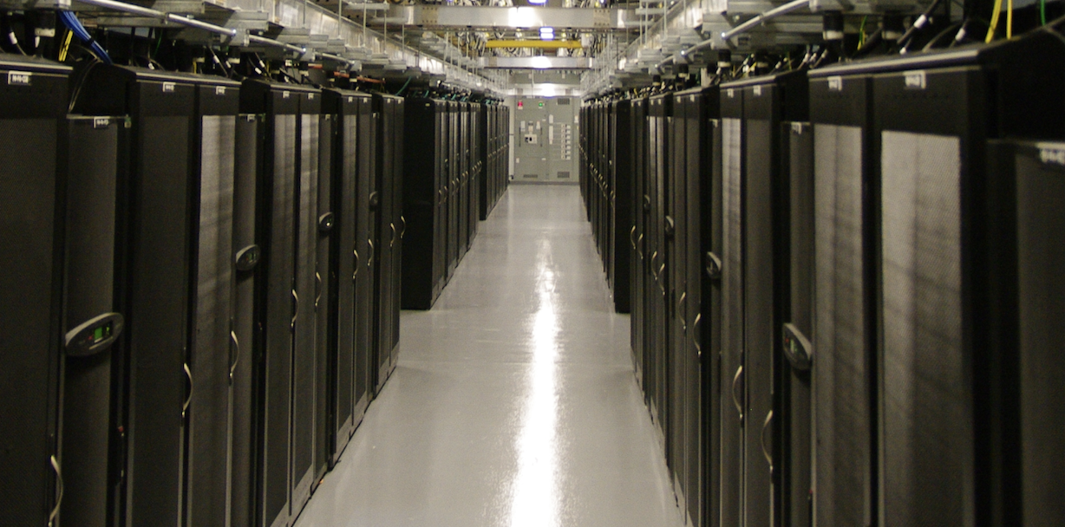
Access networks: data center networks
mobile network
high-bandwidth links (10s to 100s Gbps) connect hundreds to thousands of servers together, and to Internet
national or global ISP
local or regional ISP
home network
content
provider
network
datacenter
network
Courtesy: Massachusetts Green High Performance Computing Center (mghpcc.org)
enterprise
network

Slide 48
Switching
We have discussed that internet is a network of networks in which two or more networks are connected to each other via switches and routers.
Switching is the process of transferring data packets from one device to another in a network, or from one network to another via switches.
There are two types of switching is popular in computer networks -
Circuit Switching
Packet Switching

Slide 49
Circuit Switching
In a circuit-switched network, a dedicated connection, called a circuit, is always available between two end systems; the switch can only make it active or inactive.
In circuit-switched networks, the resources needed along a path (buffers, link transmission rate) to provide for communication between the end systems are reserved for the duration of the communication session between the end systems.
Traditional telephone networks are examples of circuit-switched networks.

Slide 50
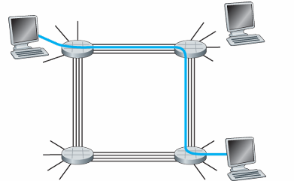
Circuit Switching
In the example, a dedicated connection (in blue) is created between two end systems. This connection or circuit will be reserved for the entire duration of communication.
Because each link has four circuits, for each link used by the end-to-end connection, the connection gets one fourth of the link’s total transmission capacity for the duration of the connection. Thus, for example, if each link between adjacent switches has a transmission rate of 1 Mbps, then each end-to-end circuit-switch connection gets 250 kbps of dedicated transmission rate.

Slide 51
Packet Switching
In a network application, end-systems exchanges messages with each other. These messages can be anything like a connection request or maybe some data transfer message like an email, file transfer, etc.
To send a message from a source end-system to a destination end-system, the source breaks long messages into smaller chunks of data known as packets.
Between source and destination, each packet travels through communication links and packet switches (routers, link-layer switches, etc.).
Packets are transmitted over each communication link at full transmission rate of the link. So if a source end system or a packet switch is sending a packet of L bits over a link with transmission rate R bits / second then the time to transmit the packet is L / R seconds.

Slide 52
Two key network-core functions
routing algorithm
Routing:
global action: determine source-destination paths taken by packets
routing algorithms
routing algorithm
Forwarding:
aka “switching”
local action: move arriving packets from router’s input link to appropriate router output link
local forwarding table
local forwarding table
header value
output link
0100
0101
0111
1001
3
2
2
1
1
3
2
0111
destination address in arriving
packet’s header

Slide 53
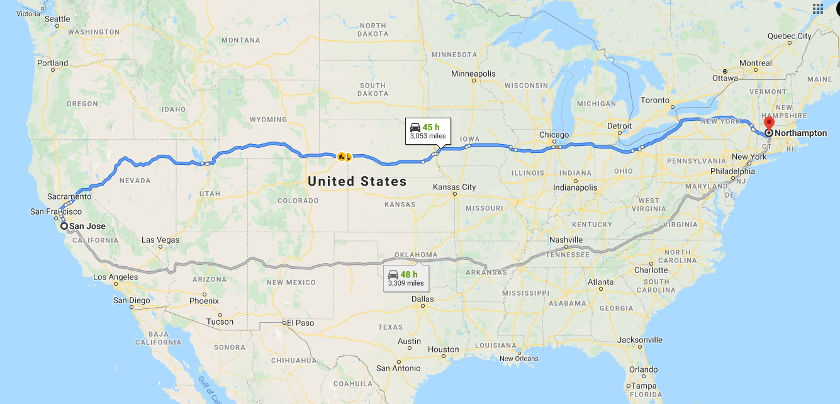
routing

Slide 54
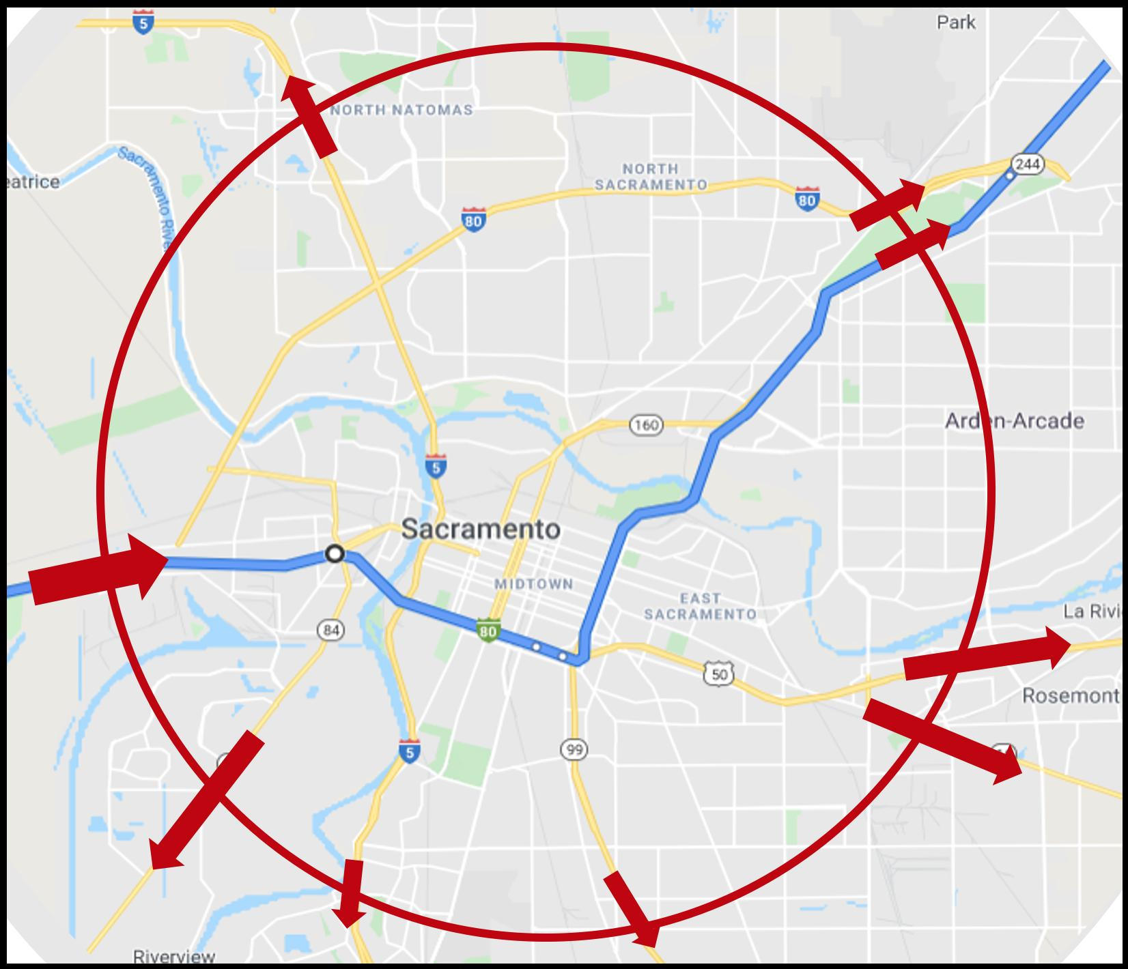
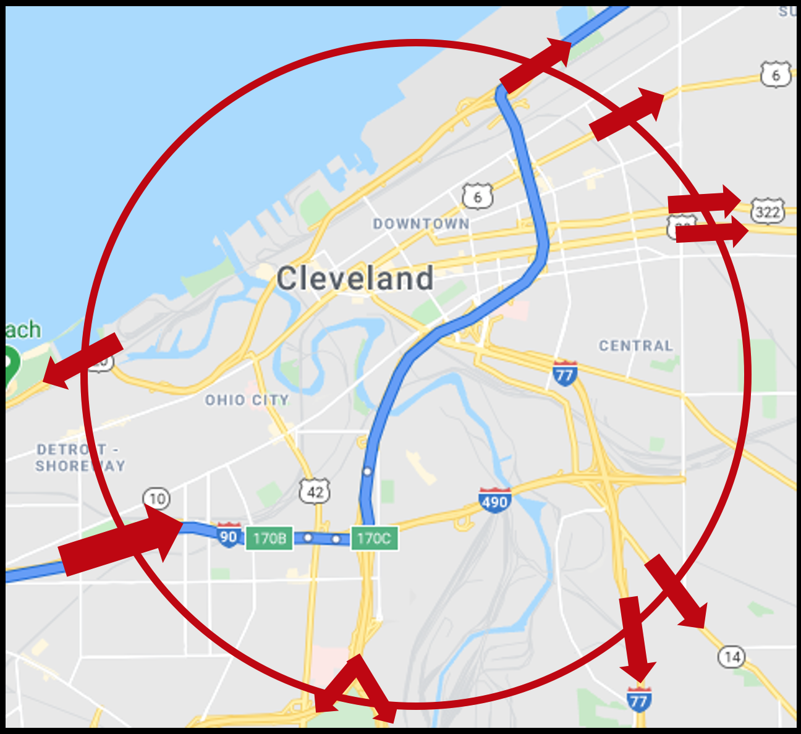
forwarding
forwarding

Slide 55




Packet-switching: store-and-forward
L bits
per packet
source
3
2
1
destination
R bps
R bps
packet transmission delay: takes L/R seconds to transmit (push out) L-bit packet into link at R bps
store and forward: entire packet must arrive at router before it can be transmitted on next link
One-hop numerical example:
L = 10 Kbits
R = 100 Mbps
one-hop transmission delay = 0.1 msec

Slide 56
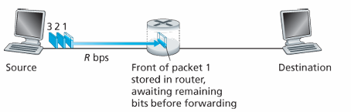
Exercise
In given example, how much time will it take for 1st packet to reach the destination? 0-L/R , L/R -> 2L/R,2L/R ->3L/R , 3L/R->4L/R
Total time taken in transmitting all three packets from source to destination?

Slide 57
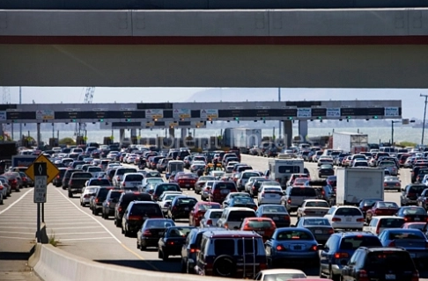

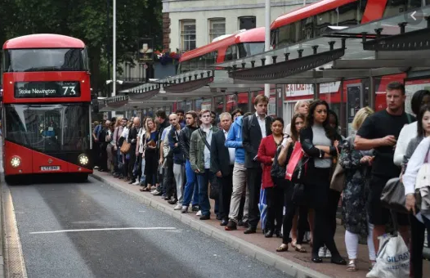
Packet-switching: queueing delays and packet loss
R = 100 Mb/s
C
A
R = 15 Mb/s
D
B
E
queue of packets
waiting for transmission over output link
Queueing occurs when work arrives faster than it can be serviced:

Slide 58
Packet-switching: queueing delays and packet loss
R = 100 Mb/s
C
A
R = 15 Mb/s
D
B
E
queue of packets
waiting for transmission over output link
Packet queuing and loss: if arrival rate (in bps) to link exceeds transmission rate (bps) of link for some period of time:
packets will queue, waiting to be transmitted on output link
packets can be dropped (lost) if memory (buffer) in router fills up

Slide 59
Packet switching versus circuit switching
example:
1 Gb/s link
each user:
100 Mb/s when “active”
active 10% of time
…..
N
users
1 Gbps link
Q: how many users can use this network under circuit-switching and packet switching?
circuit-switching: 10 users
packet switching: with 35 users, probability > 10 active at same time is less than .0004 *
Q: how did we get value 0.0004?
A: HW problem

Slide 60
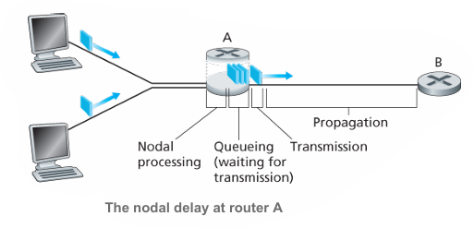
Delay in Packet-Switched Networks
As a packet travels from one node (host or router) to the subsequent node (host or router) while going from source to destination, the packet suffers from several types of delays at each node along the path.
The most important of these delays are the nodal processing delay, queuing delay, transmission delay, and propagation delay; together, these delays accumulate to give a total nodal delay.

Slide 61
Delay in Packet-Switched Networks
Nodal Processing Delay:
examine the packet header
check for the bit-level error
determine the outgoing link
possibly queue the packet before transmission.
Example A packet is travelling from Host A to Host B via a router R_1
Given : Packet size =1000 bytes , nodal processing time at router R_1=0.5ms
queueing delay:2ms, transmission rate = 1mbps, link length =200km, propagation speed=2x10^8m/s

Slide 62
Delay in Packet-Switched Networks
Example A packet is travelling from Host A to Host B via a router R_1
Given : Packet size =1000 bytes , nodal processing time at router R_1=0.5ms
queueing delay:2ms, transmission rate = 1mbps, link length =200km, propagation speed =2x10^8m/s
Ans Nodal Processing Delay = 0.5ms as stated in question,
transmission delay = packet size/ transmission rate = 8000/10^6 = 0.008seconds = 8ms
propagation delay = distance / propagation speed = 200x10^3/ 2x10^8= 0.001 seconds =1ms
Total delay = 0.5+2+8+1= 11.5ms.

Slide 63
Delay in Packet-Switched Networks
packets queue in router buffers, waiting for turn for transmission
queue length grows when arrival rate to link (temporarily) exceeds output link capacity
packet loss occurs when memory to hold queued packets fills up
packet being transmitted (transmission delay)
A
B
packets in buffers (queueing delay)
free (available) buffers: arriving packets
dropped (loss) if no free buffers

Slide 64
Packet delay: four sources
transmission
A
propagation
B
nodal
processing
queueing
d_{total} = d_{proc} + d_{queue} + d_{trans} + d_{prop}
d_{proc}: nodal processing
check bit errors
determine output link
typically < microsecs
d_{queue}: queueing delay
time waiting at output link for transmission
depends on congestion level of router

Slide 65
Packet delay: four sources
transmission
A
propagation
B
nodal
processing
queueing
d_{total} = d_{proc} + d_{queue} + d_{trans} + d_{prop}
d_{trans}: transmission delay:
L: packet length (bits)
R: link transmission rate (bps)
d_{trans} = L/R
d_{prop}: propagation delay:
d: length of physical link
s: propagation speed (~3x10⁸ m/sec)
d_{prop} = d/s
d_{trans} and d_{prop}
very different
Notes:
- Transmission delay: This is the amount of time required to push (that is, transmit) all of the packet’s bits into the link. Transmission delays are typically on the order of microseconds to milliseconds in practice.
- Propagation delay: Once a bit is pushed into the link, it needs to propagate to router B. The time required to propagate from the beginning of the link to router B is the propagation delay.

Slide 66
End-to-End Delay
So far we have discussed delay at a single router, but what about total delay in the journey of packet from source to destination?
Let’s suppose there are N routers between the source host and the destination host.
With the assumption that equal delays for the sender, routers, and receiver, the total end-to-end delay (source-to-destination delay) a packet encounters can be calculated as following -
d_{end-to-end} = (n + 1) (d_{processing} + d_{transmission} + d_{propagation} ) + n d_{queuing}
Delay can have a significant impact on real-time applications such as voice and video chats, where low delay is essential to maintain smooth communication.

Slide 67
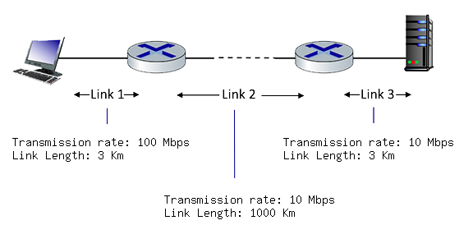
Exercise
Assume the length of a packet is 4000 bits. The propagation speed of each link is 3 x 10⁸ m / sec. Assuming processing delay and queuing delay is negligible, answer following questions.
What is the transmission delay of each link?
What is the propogation delay of each link?
What is the total end-to-end delay for one packet?
Now suppose, source starts sending 3 packets at time t, at what time server/destination will receive all packets? Can you generalize the expression for n packets?

Slide 68

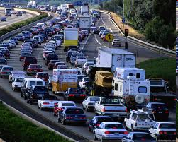
Packet queueing delay (revisited)
a: average packet arrival rate
L: packet length (bits)
R: link bandwidth (bit transmission rate)
average queueing delay
L
a
.
:
arrival rate of bits
“traffic
intensity”
R
service rate of bits
traffic intensity = La/R
1
La/R ~ 0: avg. queueing delay small
La/R -> 1: avg. queueing delay large
La/R > 1: more “work” arriving is more than can be serviced - average delay infinite!
La/R ~ 0
La/R -> 1

Slide 69
“Real” Internet delays and routes
what do “real” Internet delay & loss look like?
traceroute program: provides delay measurement from source to router along end-end Internet path towards destination. For all i:
sends three packets that will reach router i on path towards destination (with time-to-live field value of i)
router i will return packets to sender
sender measures time interval between transmission and reply
3 probes
3 probes
3 probes

Slide 70
Real Internet delays and routes
traceroute: gaia.cs.umass.edu to www.eurecom.fr
3 delay measurements from
gaia.cs.umass.edu to cs-gw.cs.umass.edu
1 cs-gw (128.119.240.254) 1 ms 1 ms 2 ms
2 border1-rt-fa5-1-0.gw.umass.edu (128.119.3.145) 1 ms 1 ms 2 ms
3 cht-vbns.gw.umass.edu (128.119.3.130) 6 ms 5 ms 5 ms
4 jn1-at1-0-0-19.wor.vbns.net (204.147.132.129) 16 ms 11 ms 13 ms
5 jn1-so7-0-0-0.wae.vbns.net (204.147.136.136) 21 ms 18 ms 18 ms
6 abilene-vbns.abilene.ucaid.edu (198.32.11.9) 22 ms 18 ms 22 ms
7 nycm-wash.abilene.ucaid.edu (198.32.8.46) 22 ms 22 ms 22 ms
8 62.40.103.253 (62.40.103.253) 104 ms 109 ms 106 ms
9 de2-1.de1.de.geant.net (62.40.96.129) 109 ms 102 ms 104 ms
10 de.fr1.fr.geant.net (62.40.96.50) 113 ms 121 ms 114 ms
11 renater-gw.fr1.fr.geant.net (62.40.103.54) 112 ms 114 ms 112 ms
12 nio-n2.cssi.renater.fr (193.51.206.13) 111 ms 114 ms 116 ms
13 nice.cssi.renater.fr (195.220.98.102) 123 ms 125 ms 124 ms
14 r3t2-nice.cssi.renater.fr (195.220.98.110) 126 ms 126 ms 124 ms
15 eurecom-valbonne.r3t2.ft.net (193.48.50.54) 135 ms 128 ms 133 ms
16 194.214.211.25 (194.214.211.25) 126 ms 128 ms 126 ms
17 * * *
18 * * *
19 fantasia.eurecom.fr (193.55.113.142) 132 ms 128 ms 136 ms
3 delay measurements
to border1-rt-fa5-1-0.gw.umass.edu
trans-oceanic link
looks like delays decrease! Why?
* means no response (probe lost, router not replying)
* Do some traceroutes from exotic countries at www.traceroute.org

Slide 71
Packet loss
queue (aka buffer) preceding link in buffer has finite capacity
packet arriving to full queue dropped (aka lost)
lost packet may be retransmitted by previous node, by source end system, or not at all
buffer
(waiting area)
A
packet being transmitted
B
packet arriving to
full buffer is lost

Slide 72
Throughput
Throughput in a packet-switched network refers to the rate at which data can be transmitted over the network link. It is usually measured in bits per second (bps) or packets per second (pps). Throughput depends upon various factors -
Link Capacity - The maximum data rate that the physical link can support. It is determined by the link’s transmission rate and bandwidth.
Network Congestion - High levels of network congestion can reduce throughput as packets experience more queueing delay and compete for available bandwidth.

Slide 73
Throughput
Protocols Overhead - Packet-switched networks use various protocols to manage and control data transmission. These protocols add some overhead, which can slightly reduce the actual throughput.
Routing Efficiency - The efficiency of the routing algorithms and protocols used in the network can impact how quickly packets reach their destination.
Throughput is crucial for applications that require high data transfer rates, such as file downloads, streaming, and data-intensive processes.

Slide 74
Throughput
R_{s} < R_{c} What is average end-end throughput?
R_{s} bits/sec
R_{c} bits/sec
R_{s} > R_{c} What is average end-end throughput?
R_{s} bits/sec
R_{c} bits/sec
bottleneck link
link on end-end path that constrains end-end throughput

Slide 75
Throughput: network scenario
per-connection end-end throughput: min(R_{c},R_{s},R/10)
in practice: R_{c} or R_{s} is often bottleneck
R_{s}
R_{s}
R_{s}
R
R_{c}
R_{c}
R_{c}
10 connections (fairly) share backbone bottleneck link R bits/sec

Slide 76
Example
Let's consider a simple network with the following parameters:
Server transmission Rate R_s=30mbps
Client transmission rate R_c=75mbps
Shared linked capacity R=300mbps
no of links = 10
end-to-end throughput for each client in this scenario is
min(R_s, R_c, 300/10)= 30mbps.

Slide 77
PROTOCOLS & LAYERED ARCHITECTURE OF INTERNET

Slide 78
Protocols
As we have discussed that internet is a complex network containing many hosts, routers, transmission links, etc. So how is this complex structure is managed or operates?
The answer is Protocols. A protocol defines the rules that both sender and receiver and all intermediate devices need to follow to be able to communicate effectively.
To reduce the complexity, the internet architecture is divided into protocol layers, where each layer serve a different purpose in the communication between two end-systems in the internet.

Slide 79
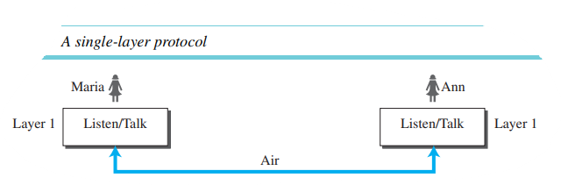
Protocols

Slide 80
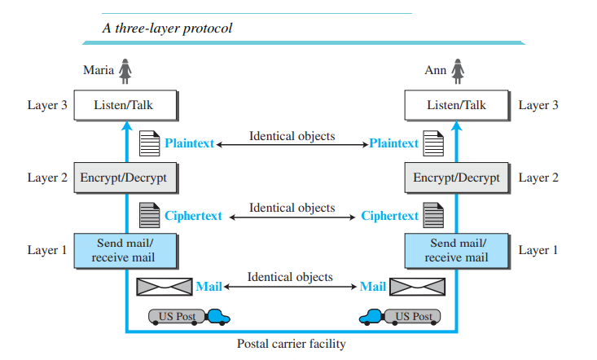
Protocols

Slide 81

Example: organization of air travel
end-to-end transfer of person plus baggage
ticket (purchase)
baggage (check)
gates (load)
runway takeoff
airplane routing
ticket (complain)
baggage (claim)
gates (unload)
runway landing
airplane routing
airplane routing
How would you define/discuss the system of airline travel?
a series of steps, involving many services

Slide 82
Example: organization of air travel
ticket (purchase)
baggage (check)
gates (load)
runway takeoff
airplane routing
ticketing service
ticket (complain)
baggage (claim)
gates (unload)
runway landing
airplane routing
baggage service
gate service
runway service
routing service
airplane routing
layers: each layer implements a service
via its own internal-layer actions
relying on services provided by layer below

Slide 83
Why layering?
Approach to designing/discussing complex systems:
explicit structure allows identification, relationship of system’s pieces
layered reference model for discussion
modularization eases maintenance, updating of system
change in layer's service implementation: transparent to rest of system
e.g., change in gate procedure doesn’t affect rest of system

Slide 84
TCP/IP Protocol Suite
TCP/IP (Transmission Control Protocol / Internet Protocol) is the protocol suite (a set of protocols organized in different layers) which is used in the internet today.
TCP/IP is a hierarchical protocol made up of interactive modules, each of which provides a specific functionality.
The term hierarchical means that each upper level protocol is supported by the services provided by one or more lower level protocols.
The original TCP/IP protocol suite was defined as four software layers built upon the hardware. Today, however, TCP/IP is thought of as a five-layer model.

Slide 85
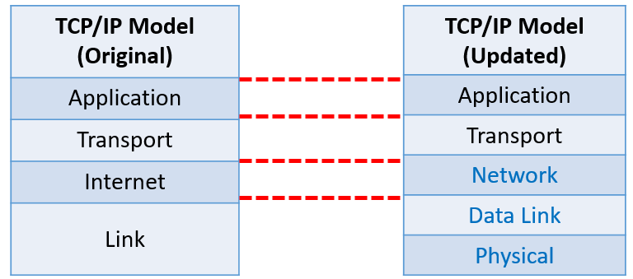
LAYERS IN TCP/IP PROTOCOL SUITE

Slide 86
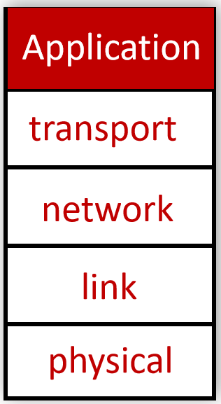
TCP/IP Protocol Suite: Application Layer
Application layer provides services directly to user applications.
It handles high-level protocols, data representation, etc.
Some protocols which reside in application layer are -
HTTP / HTTPS (HyperText Transfer Protocol) - Used in web browsing.
SMTP (Simple Mail Transfer Protocol) - Used in email services.
FTP (File Transfer Protocol) - Used in transfer of files between two end systems.
DNS (Domain Name System) - Used for checking IP address of any websites/end systems.

Slide 87
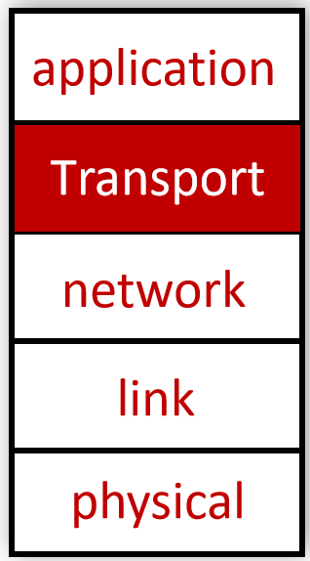
TCP/IP Protocol Suite: Transport Layer
Transport layer is responsible for the delivery of a message (segments) from one process to another.
There are two transport layer protocols - TCP (Transmission Control Protocol) and UDP (User Datagram Protocol)
TCP provides a connection-oriented service to its applications. This service includes guaranteed delivery of application-layer messages to the destination and flow control (that is, sender/receiver speed matching).
TCP also breaks long messages into shorter segments and provides a congestion-control mechanism, so that a source throttles its transmission rate when the network is congested.
The UDP protocol provides a connectionless service to its applications. This is a no-frills service that provides no reliability, no flow control, and no congestion control.

Slide 88
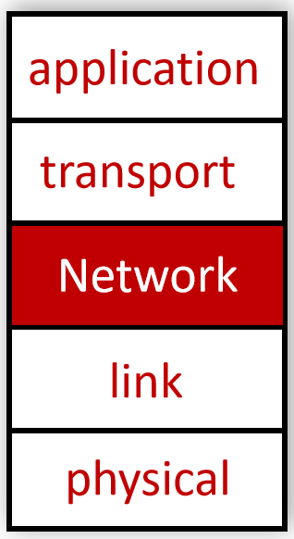
TCP/IP Protocol Suite: Network Layer
The network layer is responsible for moving network-layer packets known as datagrams from one host to another.
Transport layer in at source passes a transport-layer segment and a destination address to the network layer. The network layer then provides the service of delivering the segment to the transport layer of destination.
The network layer includes the celebrated IP protocol, which defines the fields in the datagram as well as how the end systems and routers act on these fields. There is only one IP protocol, and all Internet components that have a network layer must run the IP protocol.
The network layer also contains many routing protocols that determine the routes that datagrams take between sources and destinations.

Slide 89
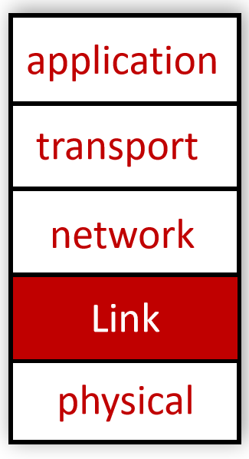
TCP/IP Protocol Suite: Link Layer
To move a packet from one node (host or router) to the next node in the route, the network layer relies on the services of the link layer.
In particular, at each node, the network layer passes the datagram down to the link layer, which delivers the datagram to the next node along the route. At this next node, the link layer passes the datagram up to the network layer.
The link layer protocols include Ethernet, WiFi, etc.
Link layer packets are known as frames.

Slide 90
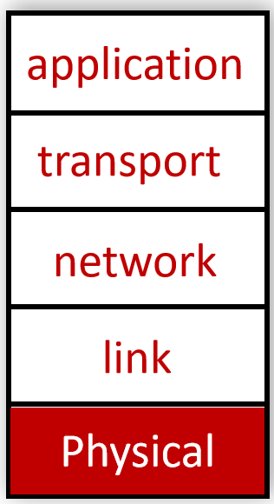
TCP/IP Protocol Suite: Physical Layer
While the job of the link layer is to move entire frames from one network element to an adjacent network element, the job of the physical layer is to move the individual bits within the frame from one node to the next.
The protocols in physical layer depends on the actual tranmission medium of the link (for example, twisted-pair copper wire, single-mode fiber optics).
For example, Ethernet has many physical-layer protocols - one for twisted-pair copper wire, another for coaxial cable, another for optical fiber, and so on. In each case, a bit is moved across the link in a different way.

Slide 91
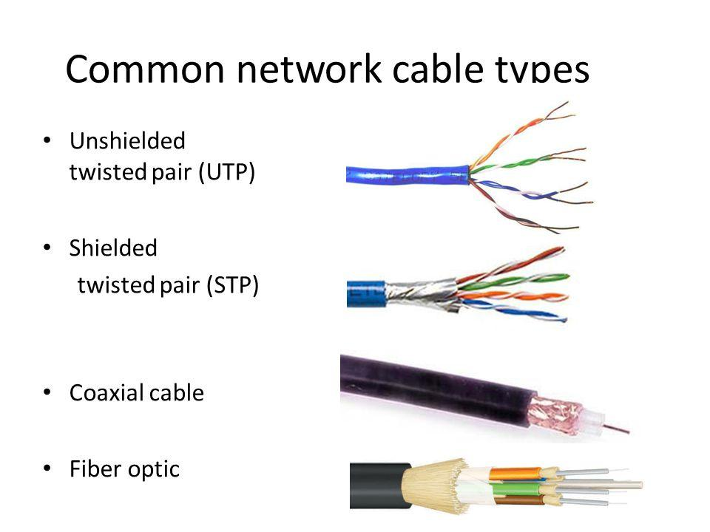

Slide 92
Layers in TCP/IP Protocol Suite
Application: supporting network applications
HTTP, FTP, SMTP, DNS
Transport: ensures process to process data transfer
TCP, UDP
Network: handles path selection or routing of datagrams from source to destination
IP, routing protocols
Link: data transfer between neighboring network elements
Ethernet, 802.11 (WiFi), PPP
Physical: bits “on the wire”
Application
application
transport
Transport
Network
network
Link
link
physical
Physical

Slide 93
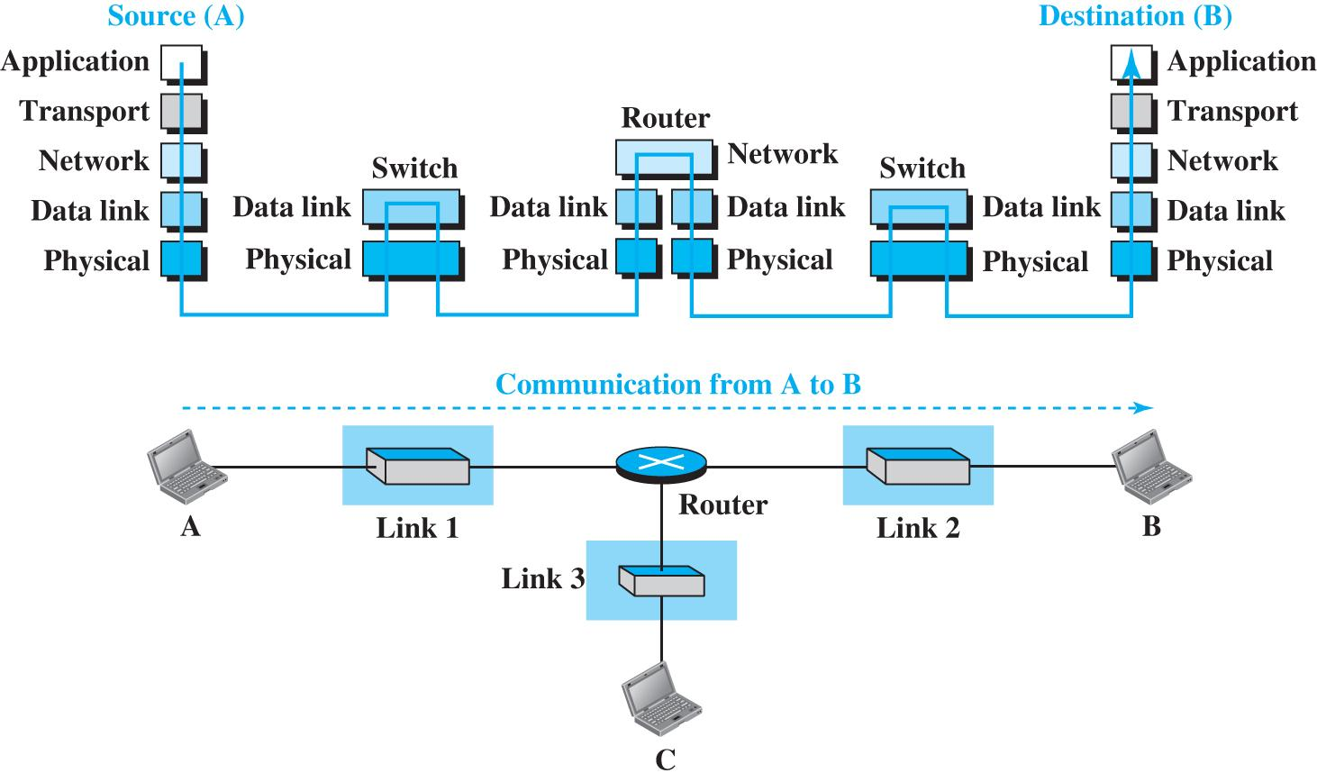
Packet Transmission in TCP/IP Stack

Slide 94
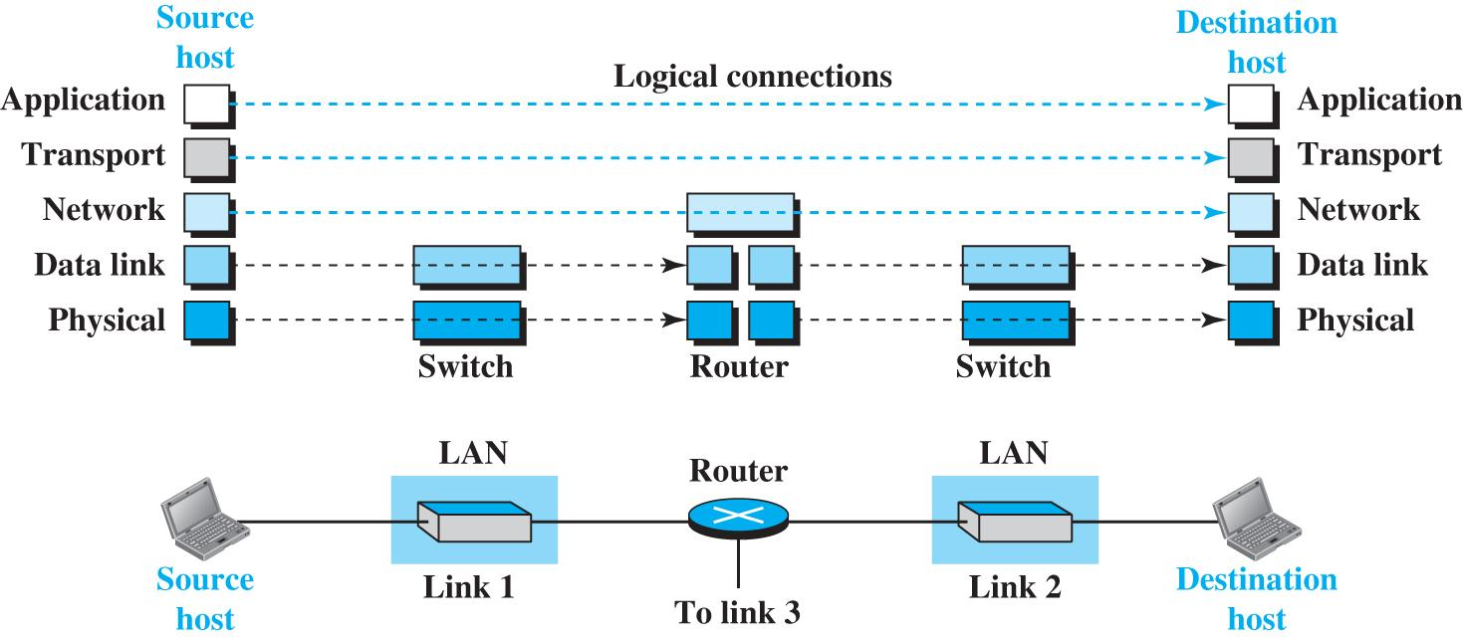
Logical Connections between layers in TCP/IP

Slide 95
Services, Layering and Encapsulation
application
transport
network
link
physical
M
application
transport
network
link
physical
Application exchanges messages to implement some application service using services of transport layer
H_{t}
M
Transport-layer protocol transfers M (e.g., reliably) from one process to another, using services of network layer
transport-layer protocol encapsulates application-layer message, M, with transport layer-layer header H_{t} to create a transport-layer segment
H_{t} used by transport layer protocol to implement its service
source
destination

Slide 96
Services, Layering and Encapsulation
H_{n}
H_{t}
M
application
transport
network
link
physical
M
application
transport
network
link
physical
H_{t}
M
H_{n}
H_{t}
M
Network-layer protocol transfers transport-layer segment [H_{t} | M] from one host to another, using link layer services
H_{l}
H_{n}
H_{t}
M
Link-layer protocol transfers datagram [H_{n}| [H_{t} |M] from host to neighboring host, using physical-layer services
link-layer protocol encapsulates network datagram [H_{n}| [H_{t} |M], with link-layer header H_{l} to create a link-layer frame
source
destination

Slide 97





Encapsulation
Matryoshka dolls (stacking dolls)
message
segment
datagram
frame
Credit: https://dribbble.com/shots/7182188-Babushka-Boi
Notes:
Thanks to Nikko Bovornkeeratiroj, Phuthipong <phuthipong@cs.umass.edu>, for the stacking dolls idea and slides

Slide 98
Services, Layering and Encapsulation
application
transport
network
link
physical
application
transport
network
link
physical
message
M
M
segment
H_{t}
M
H_{t}
M
datagram
H_{n}
H_{t}
M
H_{n}
H_{t}
M
frame
H_{l}
H_{n}
H_{t}
M
H_{l}
H_{n}
H_{t}
M
source
destination

Slide 99
Encapsulation: an end-end view
source
message
M
application
transport
network
link
physical
segment
H_{t}
M
H_{t}
datagram
H_{n}
H_{t}
H_{n}
M
frame
H_{l}
H_{n}
H_{t}
M
link
physical
switch
destination
H_{n}
H_{t}
M
network
link
physical
M
application
transport
network
link
physical
H_{l}
H_{n}
H_{t}
M
H_{n}
H_{t}
M
H_{t}
M
H_{n}
H_{t}
M
H_{l}
H_{n}
H_{t}
M
router

Slide 100
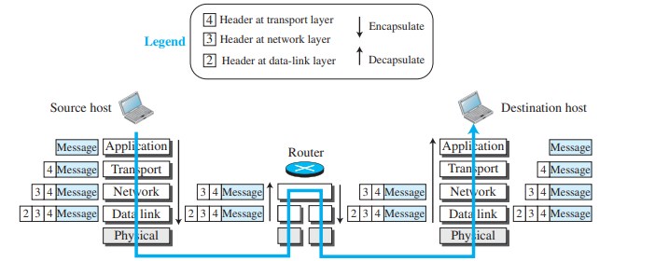
Encapsulation and Decapsulation

Slide 101
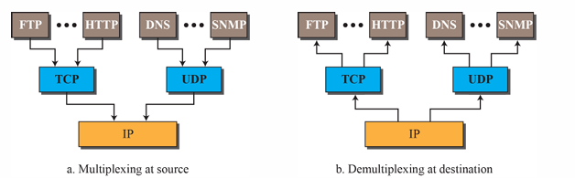
Multiplexing and Demultiplexing
Multiplexing - At the source, a protocol at a layer can take data packets from several next-higher layer protocols one at a time and encapsulate them together. This means that data from different applications can be combined into a single packet.
Demultiplexing - At the destination, the receiving protocol can identify and extract the encapsulated packets from the received data packet and deliver them to their respective next-higher layer protocols one at a time. This ensures that the data is correctly routed to the appropriate application or service.

Slide 102
The OSI Model
Established in 1947, the International Organization for Standardization (ISO) is a multinational body dedicated to worldwide agreement on international standards.
An ISO standard that covers all aspects of network communications is the Open Systems Interconnection (OSI) model. It was first introduced in the late 1970s.
An open system is like a universal translator that enables different systems to talk to each other, regardless of their differences. The OSI model is a blueprint that shows how to make this communication happen without changing the underlying hardware or software.
The OSI model is a layered framework for the design of network systems that allows communication between all types of computer systems. It consists of seven separate but related layers, each of which defines a part of the process of moving information across a network.

Slide 103
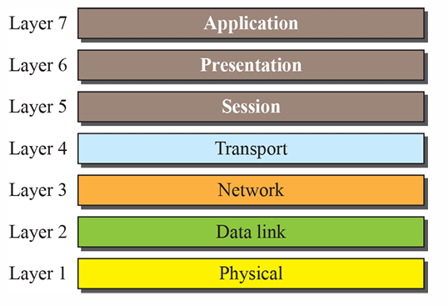
The OSI Model

Slide 104
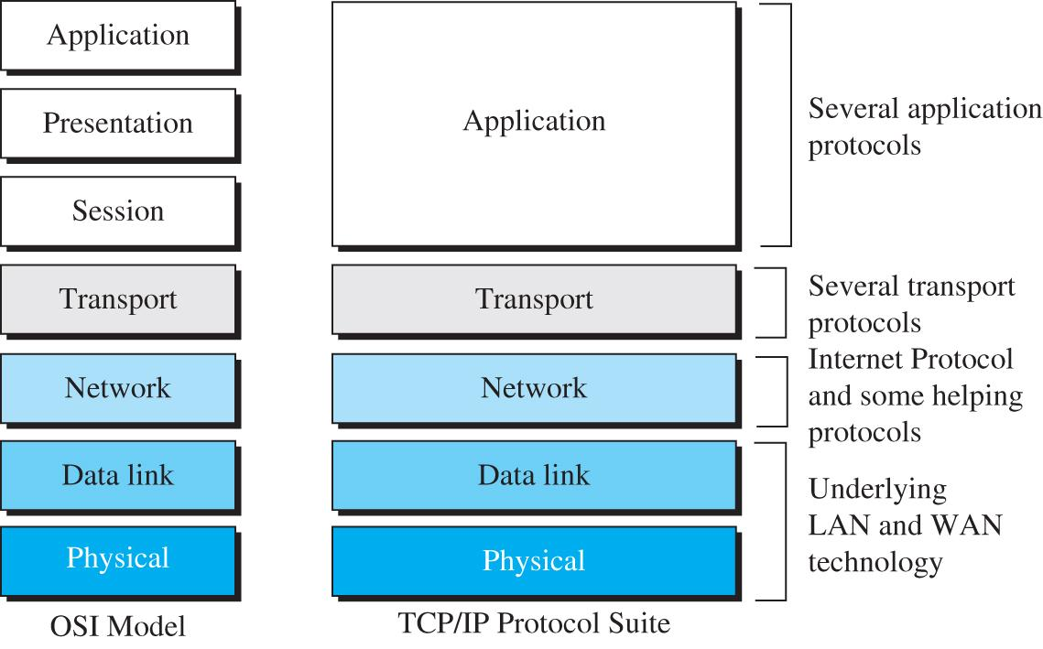
OSI Vs TCP/IP

Slide 105
OSI vs TCP/IP
Multiple Transport-layer Protocols: TCP/IP has more than one transport-layer protocol, and some of them provide functionalities that were originally associated with the session layer in the OSI model.
Application Layer Variability: The application layer in TCP/IP is not limited to a single piece of software. Instead, multiple applications can be developed at this layer. If a specific application requires functionalities similar to those in the session and presentation layers, those functionalities can be included in the application's development.
The absense of session and presentation layers in TCP/IP was a deliberate decision, influenced by the presence of multiple transport layer protocols and the flexibility of the application layer to accommodate various application specific functionalities.

Slide 106
Lack of OSI Model’s Success
Timing and Cost: By the time the OSI model was completed, TCP/IP was already widely implemented and used. Switching to the OSI model would have required a significant amount of time, effort, and money to replace the existing TCP/IP infrastructure, which was not practical.
Incomplete Definitions: Some layers in the OSI model, like the presentation and session layers, were not fully defined with concrete protocols and software. Although the services provided by these layers were listed, the actual implementation details were lacking, making it difficult for organizations to adopt them.
Performance Issues: When organizations attempted to implement the OSI model in different applications, it didn't demonstrate significantly better performance than the established TCP/IP protocol suite. As a result, there was no compelling reason for the Internet authority to switch from TCP/IP to OSI.

